Slide 1
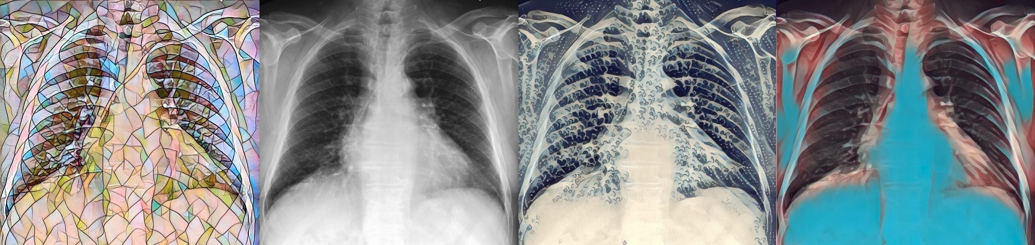
Deep learning and CXRs
Alistair Johnson
June 20th, 2021

Slide 2
Lessons from this tutorial
Learn about the domain you are working in
Understand the data generation process
Ask yourself: what data don’t I have?

Slide 3
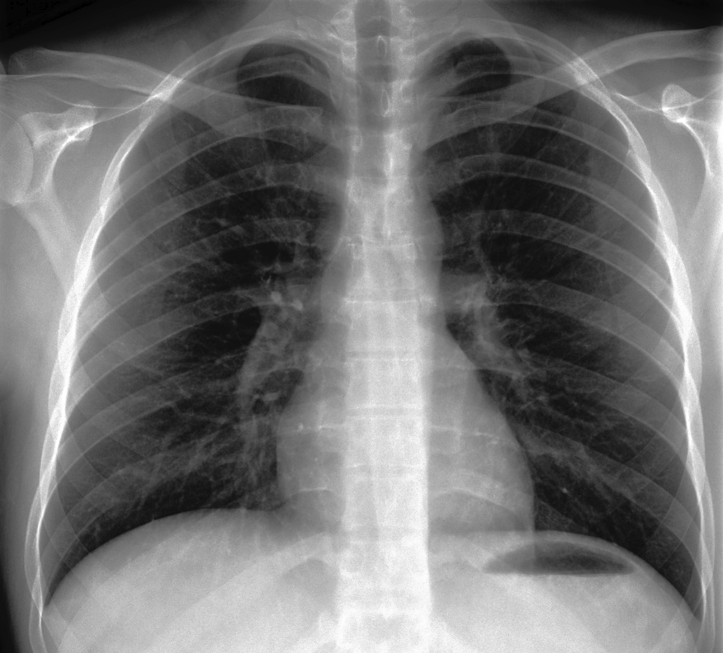
Chest radiographs
Commonly called X-rays
(“X” stands for “I have no idea what this thing is but look I see through people’s skin”)
Visualizes the lungs
Visualizes the heart
What do radiologists look for in these x-rays?

Slide 4
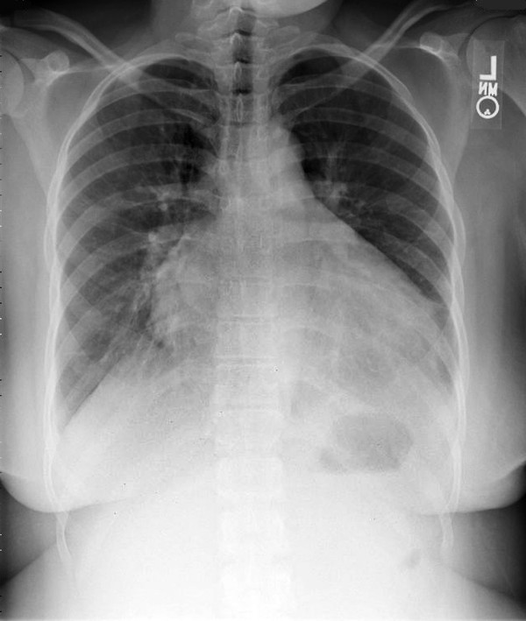
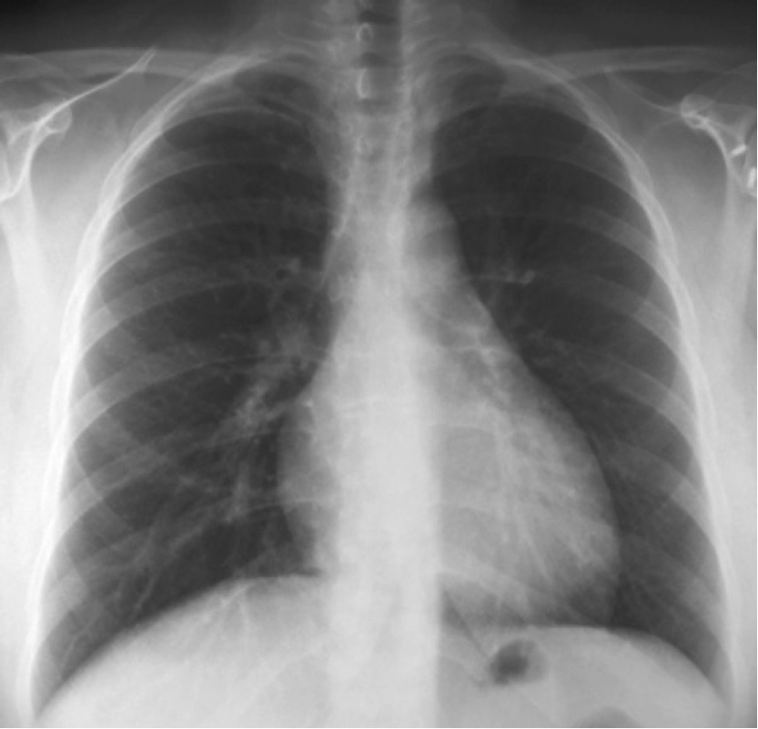
What do we look for in a CXR?
A big heart, “cardiomegaly”
(and not in a good way!)
big!
OK

Slide 5
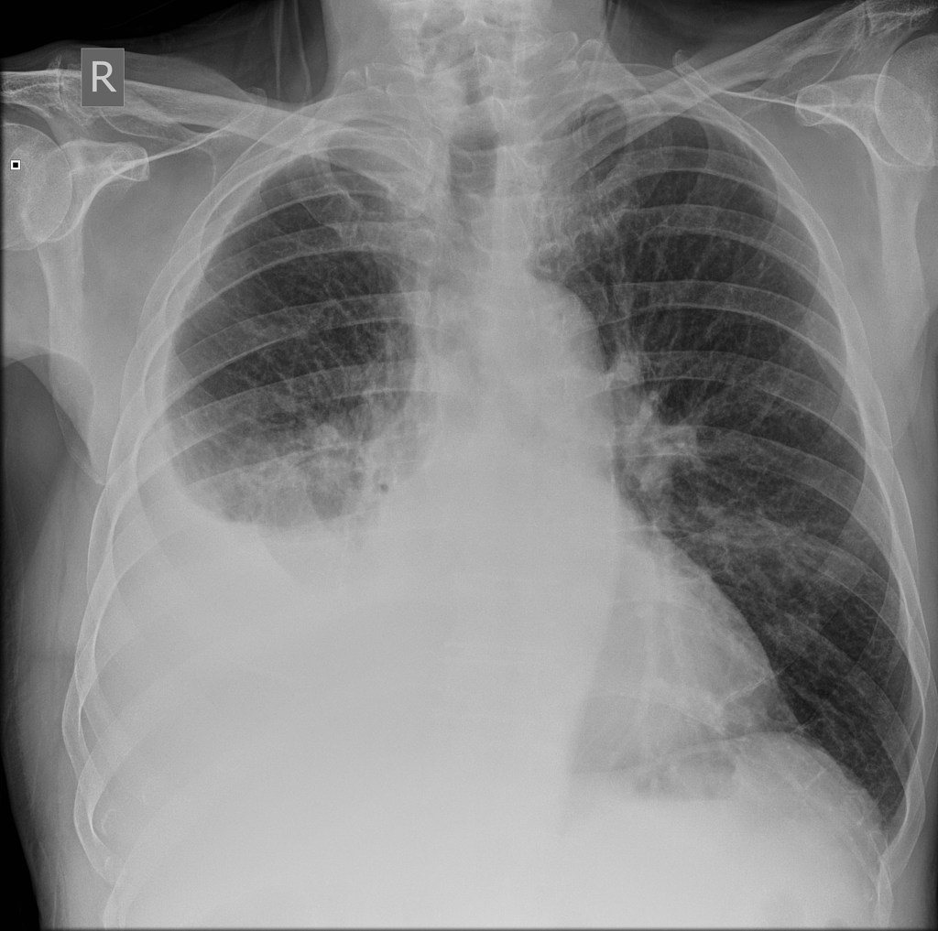
What do we look for in a chest x-ray?
Water where it is not supposed to be
water
air

Slide 6
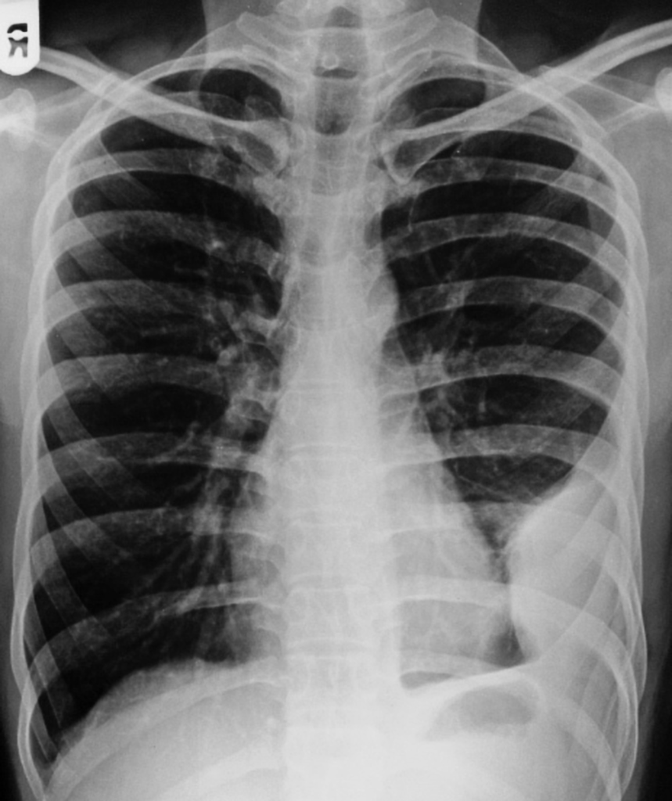
What do we look for in a chest x-ray?
Water Fluid where it is not supposed to be
Blood? Water? Pus?

Slide 7
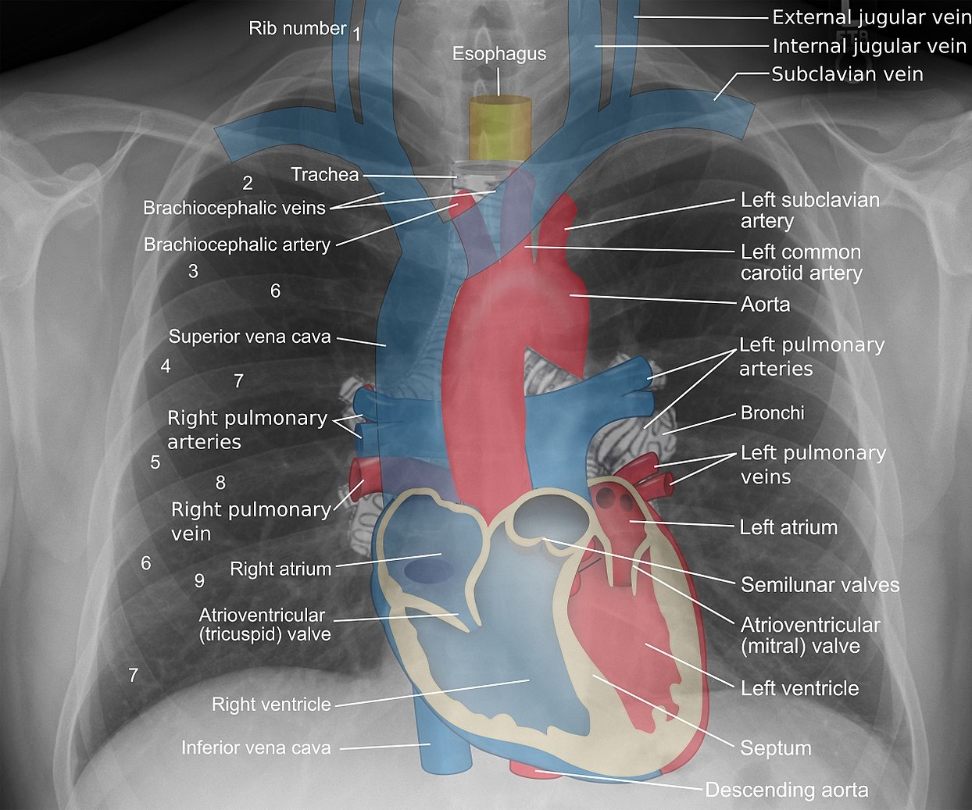
Chest radiographs
Radiologists have a strong mental model of what a CXR should look like
Mikael Häggström, M.D. "A pictorial essay: Radiology of lines and tubes in the intensive care unit". Indian Journal of Radiology and Imaging 21 (3): 182.

Slide 8
Why should we automate x-ray interpretation?
“My mom is a radiologist! Don’t take her job!”
12 million people in Rwanda, 11 radiologists [1]
4 million people in Libya, 2 radiologists [1]
Most radiologists are in urban settings [2]
Delays in medical image interpretation are bad
[1] Abi Rimmer. Radiologist shortage leaves patient care at risk, warns royal college. BMJ: British Medical Journal.
[2] Cook PS. The challenges of providing interventional radiology services to rural and smaller community hospitals. American Journal of Roentgenology. 2018 Oct;211(4):744-7.

Slide 9
What do we need to train a CXR model?
Data
Models
A lot of free time

Slide 10
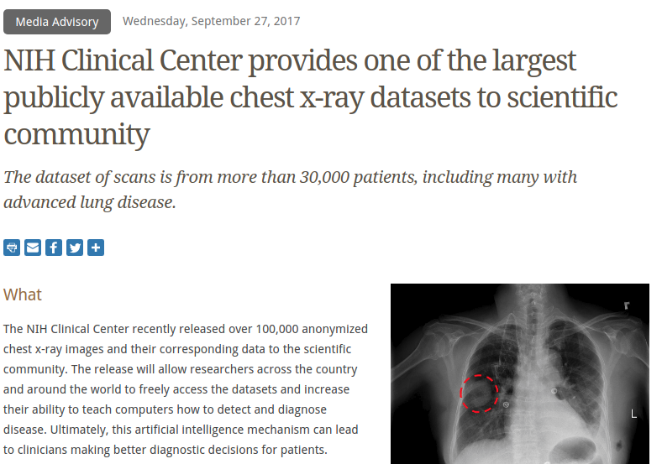
NIH to the rescue!
30,000+ patients
100,000+ images
Each associated with 14 labels
Derived automatically from the free-text report
Freely, publicly available
https://www.nih.gov/news-events/news-releases/nih-clinical-center-provides-one-largest-publicly-available-chest-x-ray-datasets-scientific-community

Slide 11
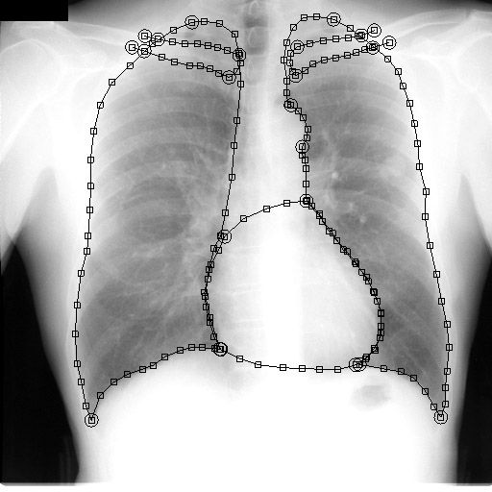
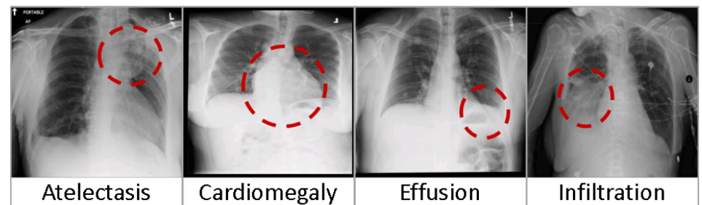
Others join in the data sharing craze
Currently available chest x-ray datasets
JSRT Database - 247 DICOMs, have heart + lung segmentation
Open-I Indiana University CXR - 8121 DICOMs, 3996 reports
ChestXray14 (ChestXray8) - 112,120 PNGs, 14 labels
MIMIC-CXR-JPG - 369,188 JPGs, 14 labels
MIMIC-CXR - same as above, full resolution DICOMs + actual text
VinDr-CXR - 18,000 PA views, 28 labels
22 labels are bounding boxes
CheXpert - 224,316 JPGs, 14 labels
PadChest - 160,000 PNGs
174 findings / 19 dx / 104 anatomy
UMLS coded
RSNA + Kaggle - too many to list!
Warning: may overlap with other datasets
Notes:
Images sourced from JSRT and NIH Chest-Xray14 papers.

Slide 12
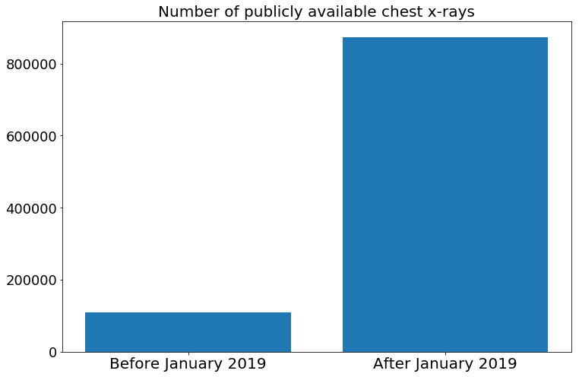
We live in exciting times!
We have data.
Notes:
import matplotlib.pyplot as plt
plt.figure(figsize=[12, 8])
plt.bar([0, 1], [108948, 108948+168861+224316+371920])
plt.yticks(fontsize=18)
plt.xticks([0, 1], ['Before January 2019', 'After January 2019'], fontsize=20)
plt.title('Number of publicly available chest x-rays', fontsize=20)
plt.show()

Slide 13
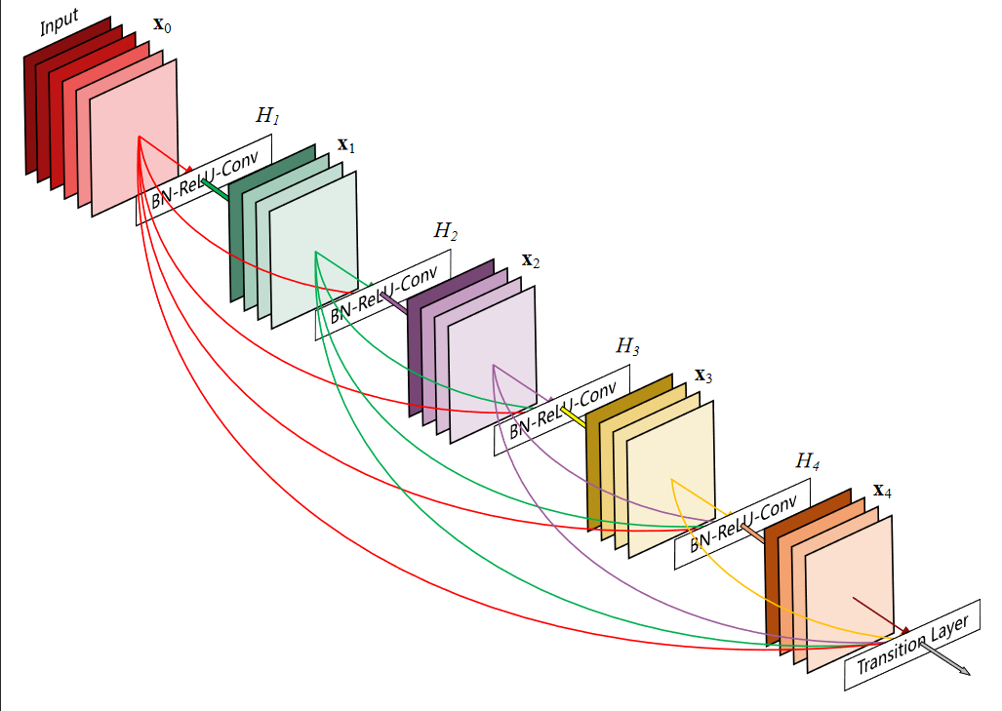
Model
DenseNet-121
Chosen as it performed well in past publications
Huang G, Liu Z, Van Der Maaten L, Weinberger KQ. Densely connected convolutional networks. In Proceedings of the IEEE conference on computer vision and pattern recognition 2017 (pp. 4700-4708).

Slide 14
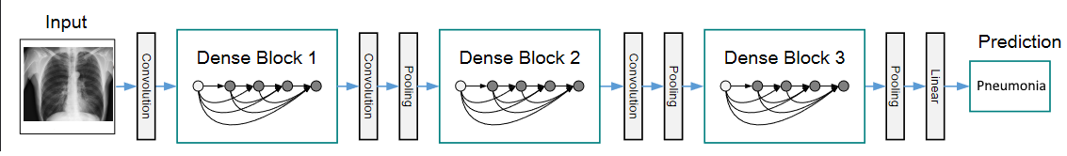
CheXNet - Classify Pneumonia
Classify chest x-rays using a large labeled dataset
Compare to domain experts (radiologists)
Rajpurkar P, Irvin J, Zhu K, Yang B, Mehta H, Duan T, Ding D, Bagul A, Langlotz C, Shpanskaya K, Lungren MP. Chexnet: Radiologist-level pneumonia detection on chest x-rays with deep learning. arXiv preprint arXiv:1711.05225. 2017 Nov 14.
Also worth a read: Bálint Botz, “A Few Thoughts About CheXNet — And The Way Human Performance Should (And Should Not) Be Measured”
Notes:
https://arxiv.org/abs/2002.02497

Slide 15
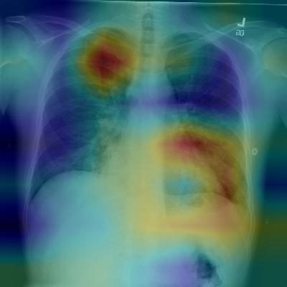
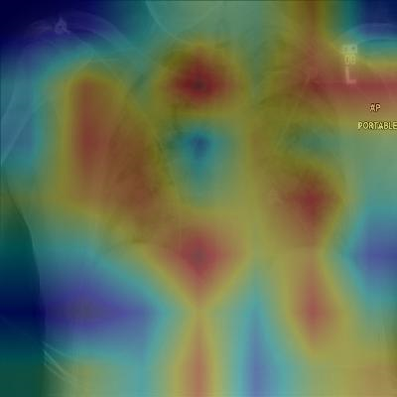


CheXNet - Classify Pneumonia
Rajpurkar P, Irvin J, Zhu K, Yang B, Mehta H, Duan T, Ding D, Bagul A, Langlotz C, Shpanskaya K, Lungren MP. Chexnet: Radiologist-level pneumonia detection on chest x-rays with deep learning. arXiv preprint arXiv:1711.05225. 2017 Nov 14.
Notes:
https://arxiv.org/abs/2002.02497

Slide 16
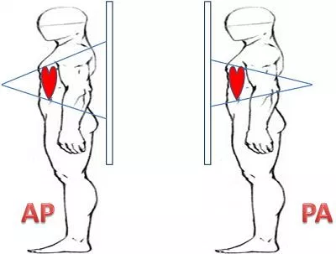
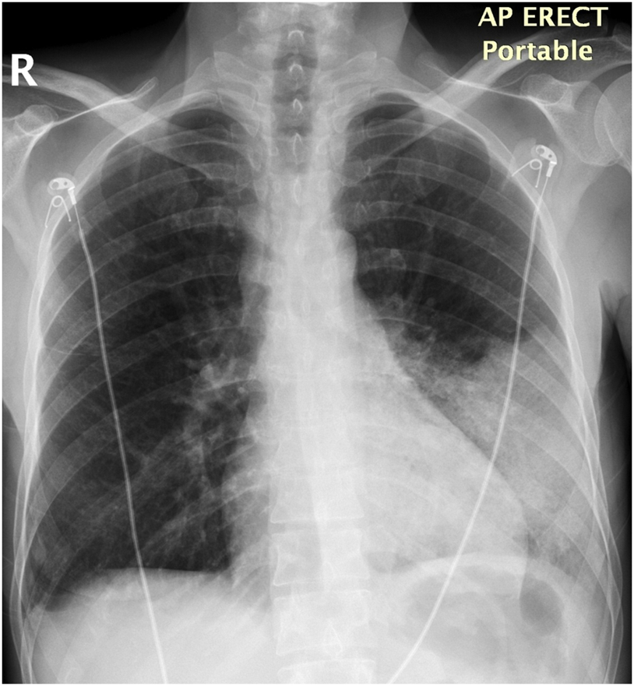
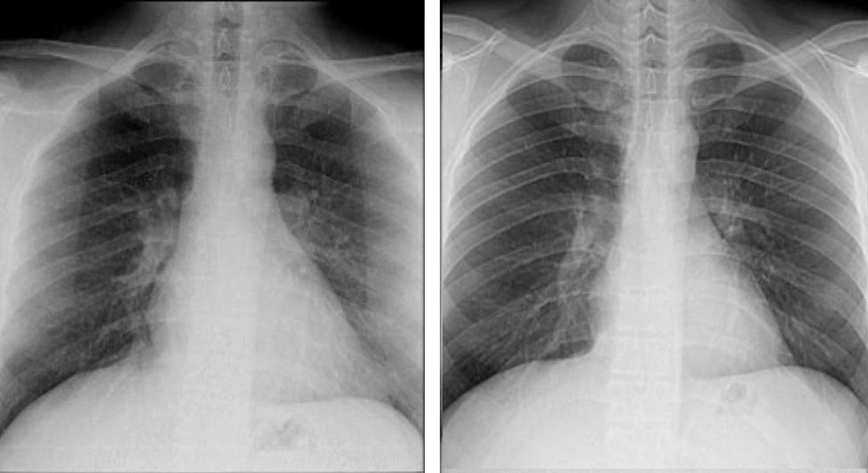
Understand the data generating process

Slide 17
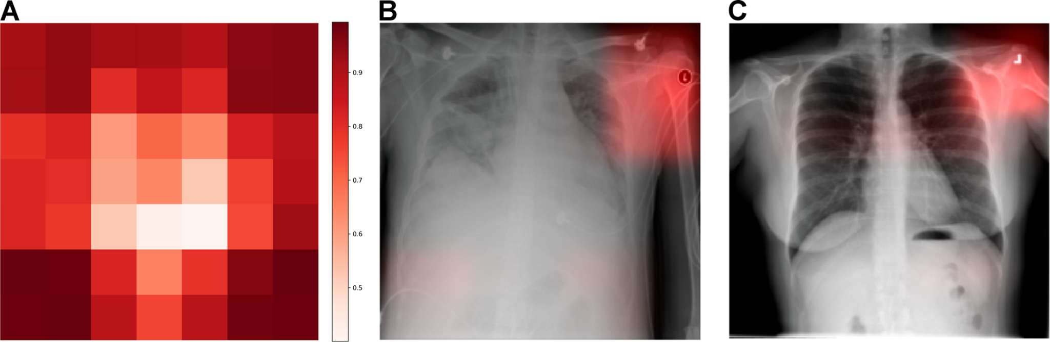
Issue #1: we are using non-causal features
Average Grad-CAM
Classifying hospital A from hospital B
Zech JR, Badgeley MA, Liu M, Costa AB, Titano JJ, Oermann EK. Variable generalization performance of a deep learning model to detect pneumonia in chest radiographs: a cross-sectional study. PLoS medicine. 2018 Nov 6;15(11):e1002683.
Notes:
Zech JR, Badgeley MA, Liu M, Costa AB, Titano JJ, Oermann EK. Variable generalization performance of a deep learning model to detect pneumonia in chest radiographs: a cross-sectional study. PLoS medicine. 2018 Nov 6;15(11):e1002683.
Geirhos R, Jacobsen JH, Michaelis C, Zemel R, Brendel W, Bethge M, Wichmann FA. Shortcut learning in deep neural networks. Nature Machine Intelligence. 2020 Nov;2(11):665-73.

Slide 18
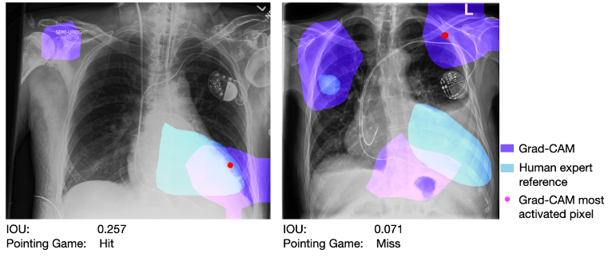
Issue #1: we are using non-causal features
Good saliency
Bad saliency
Saporta A, Gui X, Agrawal A, Pareek A, Truong SQ, Nguyen CD, Ngo VD, Seekins J, Blankenberg FG, Ng A, Lungren MP. Deep learning saliency maps do not accurately highlight diagnostically relevant regions for medical image interpretation. medRxiv. 2021 Jan 1.

Slide 19
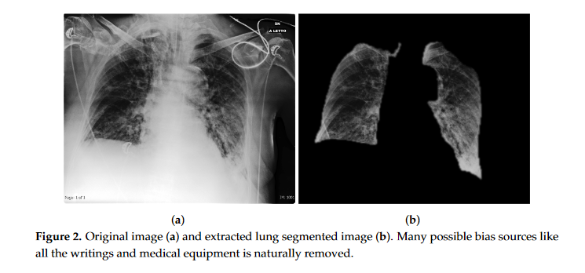
Solution: block out the non-causal factors
Tartaglione E, Barbano CA, Berzovini C, Calandri M, Grangetto M. Unveiling covid-19 from chest x-ray with deep learning: a hurdles race with small data. International Journal of Environmental Research and Public Health. 2020 Jan;17(18):6933.

Slide 20
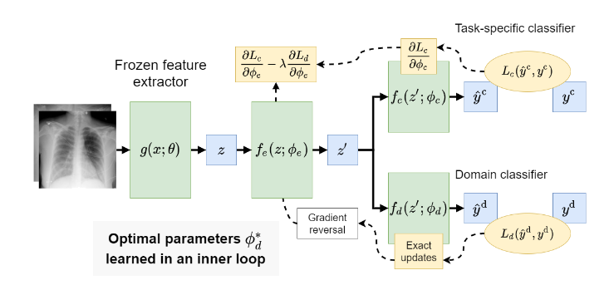
Solution: explicitly model the non-causal factors
Robinson C, Trivedi A, Blazes M, Ortiz A, Desbiens J, Gupta S, Dodhia R, Bhatraju PK, Liles WC, Lee A, Kalpathy-Cramer J. Deep learning models for COVID-19 chest x-ray classification: Preventing shortcut learning using feature disentanglement. medRxiv. 2021 Jan 1.

Slide 21
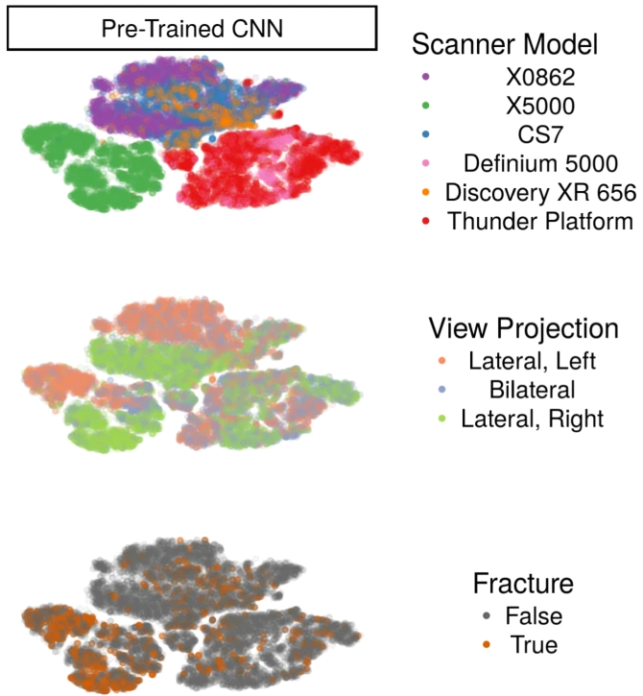
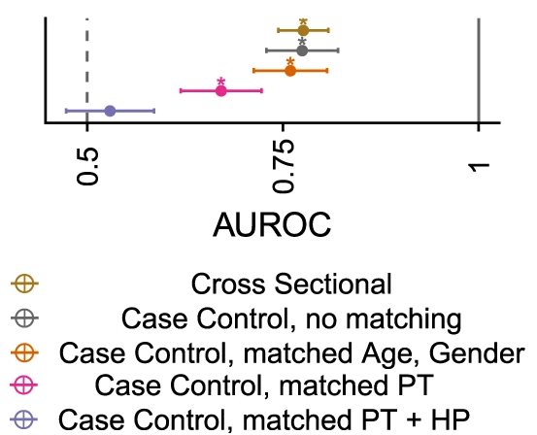
Solution: stratify the patient population
Models adjusted for demographic and process factors have significantly weakened performance
Badgeley MA, Zech JR, Oakden-Rayner L, Glicksberg BS, Liu M, Gale W, McConnell MV, Percha B, Snyder TM, Dudley JT. Deep learning predicts hip fracture using confounding patient and healthcare variables. NPJ digital medicine. 2019 Apr 30;2(1):1-0.

Slide 22
Issue #2: we are using noisy labels
FINDINGS:
Coarse bilateral interstitial opacities are consistent with patient's known
interstitial lung disease. There is minimally increased prominence of
pulmonary vasculature and heart size compared to prior, possibly secondary to
slightly lower lung volumes and/or interval hydration/fluid overload. Mild
congestive heart failure cannot be excluded. No pleural effusion or
pneumothorax is seen. Underlying interstitial lung disease slightly limits
evaluation for pneumonia, but no new large opacities are detected. Aortic
calcification is again seen. A nasogastric tube traverses below the
diaphragm, distal tip not well seen.
> Labeled as Positive for Pneumonia
Notes:
MIMIC-CXR dicom_id 90bba64d-6913b983-a1740cf9-5fb87f7e-9171482d
p13/p13854372/s51110207.txt
“Underlying interstitial lung disease slightly limits evaluation for pneumonia, but no new large opacities are detected.”
-> pneumonia positive, but we can interpret this as negative

Slide 23
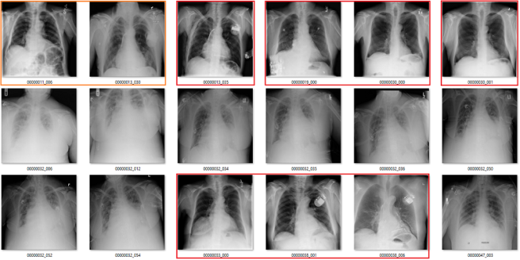
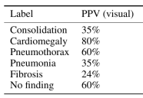
Issue #2: we are using noisy labels
All of these were supposed to be atelectasis
But many clearly aren’t
Consistent across labels
Red = I disagree
Orange = eh, I’m not sure
Oakden-Rayner L. Exploring large-scale public medical image datasets. Academic radiology. 2020 Jan 1;27(1):106-12.

Slide 24
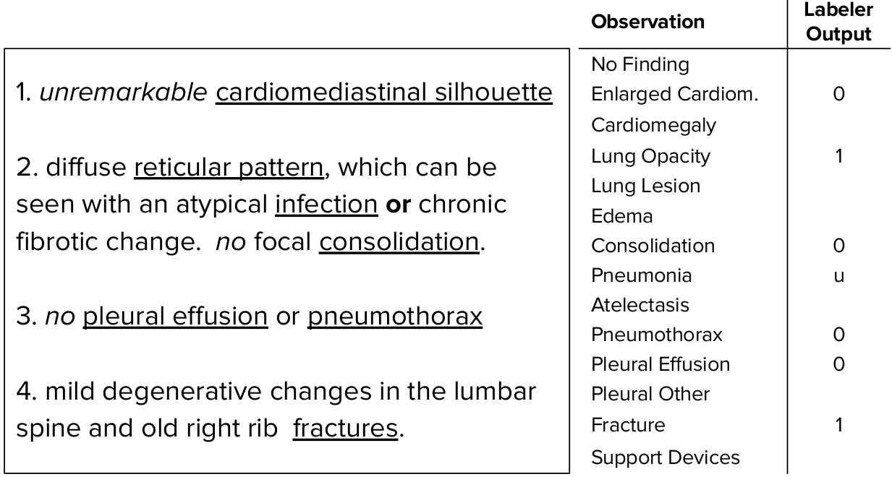
Solution: improve processing of the notes
NegBio / CheXPert algorithms parse free-text notes to identify negations and uncertainty - not easy
Later sessions will talk recent developments!

Slide 25
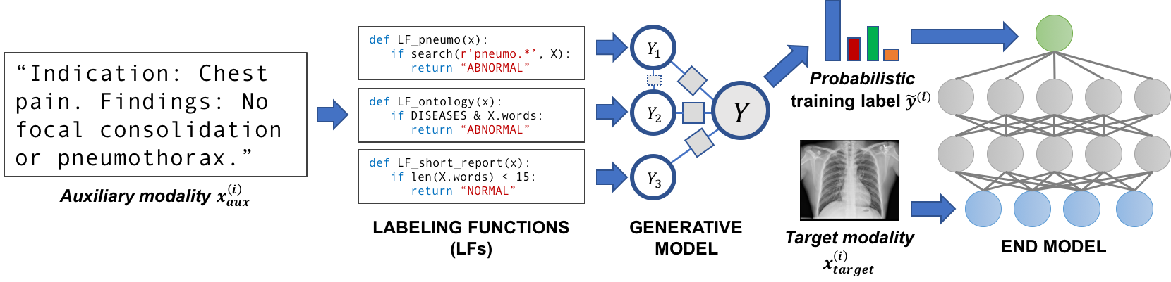
Solution: learn with noisy labels
Iteratively build labeling functions, and use “unlabeled” data
Dunnmon JA, Ratner AJ, Saab K, Khandwala N, Markert M, Sagreiya H, Goldman R, Lee-Messer C, Lungren MP, Rubin DL, Ré C. Cross-modal data programming enables rapid medical machine learning. Patterns. 2020 May 8;1(2):100019.

Slide 26
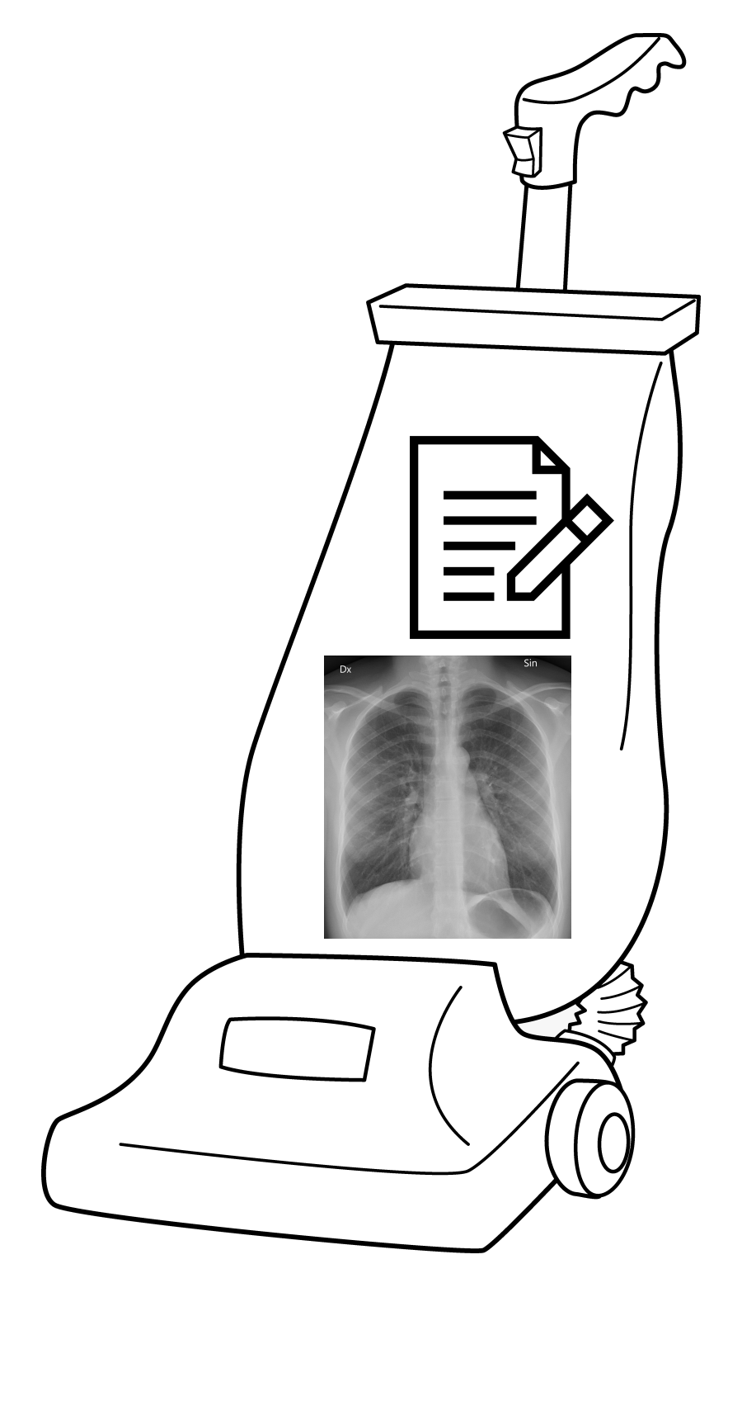
Issue #3: we are not incorporating clinical context

Slide 27
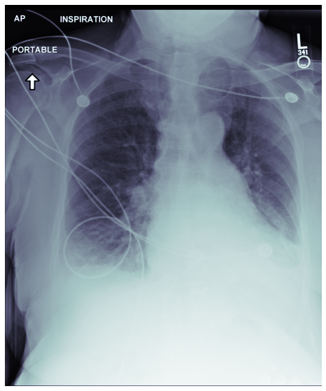
Radiologist reports...
CLINICAL INFO: 78 year old female.
FINDINGS:
Let’s write this section together!

Slide 28
Radiologist reports...
CLINICAL INFO: 78 year old female.
FINDINGS:
Let’s write this section together!

Slide 29
Radiologist reports...
CLINICAL INFO: 78 year old female.
FINDINGS:
Patient has twelve pairs of ribs, and two clavicle bones. They have both of their lungs, and their heart is located between their two lungs. Both clavicle bones are in place and no fractures there. I can see one humerus but the other is out of view..

Slide 30
RRs are not the whole story!
CLINICAL INFO: 78 year old female.
INDICATION: ___ year old woman with large goiter and hypercapnic acute on chronic respiratory failure. Please assess for diaphgramatic elevation or other intraparenchymal abnormality.
IMPRESSION: Moderate pulmonary congestion and mild interstitial edema is increased, moderate right pleural effusion is new, and moderate left basilar atelectasis is increased since ___, consistent with acute CHF exacerbation.

Slide 31



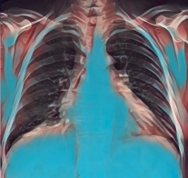



Workflow for an ED admission for pneumonia
Patient triaged
Diagnostics
Admit
Recover
Home
Triage note
Vital signs
History
Bloodwork
CXRs
Physical
Treatment
Monitoring
Notes:
https://www.ahrq.gov/sites/default/files/wysiwyg/professionals/quality-patient-safety/quality-resources/tools/cap-toolkit/ed-workflowdiagrams.pdf

Slide 32





Thanks!
CVPR tutorial site
https://bionlplab.github.io/cvpr2021tutorial/
Train your own model and evaluate it using Google Colab
https://alistairewj.github.io/talk/2021-cvpr-cxr-tutorial/
… and thanks to all those who made data available!

